Slide 1
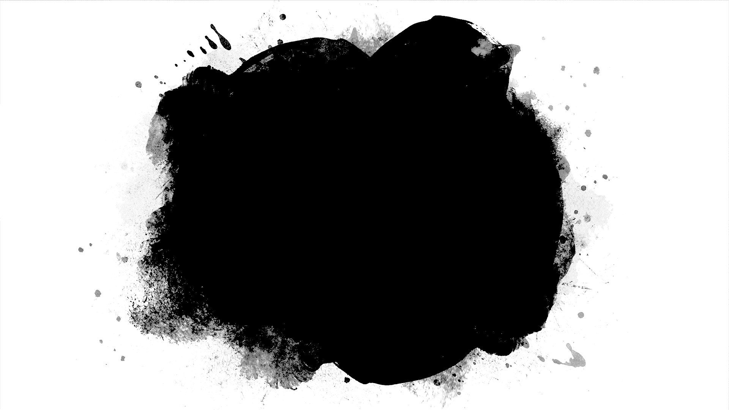
Assignment

Slide 2
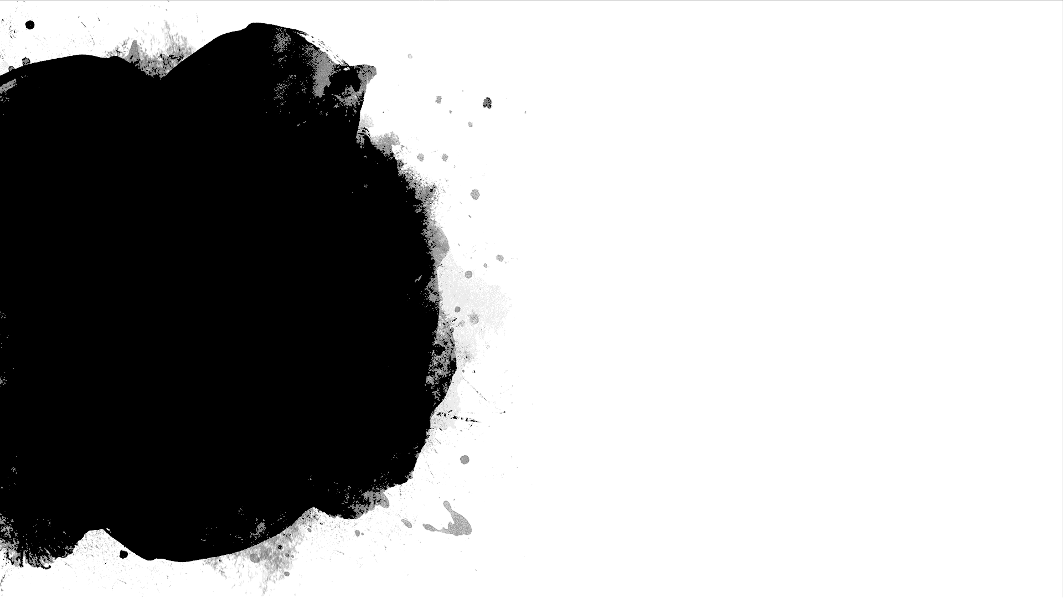
Assignment 1
Write a method that returns the English name of the last digit of a given number. Example: for 512 prints "two"; for 1024 → "four".

Slide 3
Assignment 2
Create a method GetMax() with two integer (int) parameters, that returns maximal of the two numbers. Write a program that reads three numbers from the console and prints the biggest of them. Use the GetMax() method you just created.

Slide 4
Assignment 3
Write a program in C# Sharp to read any Month Number in integer and display Month name in words. (Apply this for Days of the week)
{Use a method and switch cases}

Slide 5
Assignment 4
Write a method that determines the state of two numbers entered by the user. (Hint; the method gets two numbers of type int, and according to it returns to the console "Positive", "Negative" or "Zero“ for each of the integers:)

Slide 6
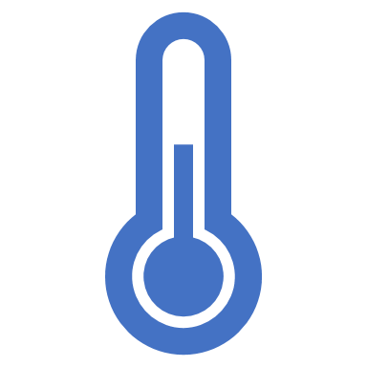
Assignment 5
Write a program that for a given (by the user) body temperature, measured in Fahrenheit degrees, has to convert that temperature and output it in Celsius degrees, with the following message: "Your body temperature in Celsius degrees is X", where X is respectively the Celsius degrees. In addition if the measured temperature in Celsius is higher than 37 degrees, the program should warn the user that they are ill, with the following message "You are ill!". {Hint; Use a method}
(Celsius to Fahrenheit formula : °C = (°F - 32) * 5 / 9, )

Slide 7
Assignment 6
Write a method that prints the digits of a given decimal number in a reversed order. For example 256, must be printed as 652.

Slide 8
Assignment 7
Create a program such that when you enter a character from the keyboard, the program checks if the input character is a letter. If it is a letter, it checks if it is lowercase or uppercase.
(Use Methods)

